Slide 1


Ontology-Based Investigation Tactics
John Beverley
Assistant Professor, University at Buffalo
Co-Director, National Center for Ontological Research
Affiliate Faculty, Institute of Artificial Intelligence and Data Science

Slide 2
Outline
Mill’s Methods
Formal Properties of Relations

Slide 3
Outline
Mill’s Methods
Formal Properties of Relations

Slide 4

Agreement
If all cases where an effect occurs have a single factor C in common, then C is the cause of the effect

Slide 5
Agreement
If all cases where an effect occurs have a single factor C in common, then C is the cause of the effect
If several people become ill after eating the same food, then that food is the cause of the illness

Slide 6
Illustrative Example
 | Oysters | Beef | Salad | Cake | Sick
John | Yes | Yes | Yes | Yes | Yes
Sally | Yes | No | No | Yes | Yes
Frank | Yes | Yes | No | No | Yes
Otto | Yes | No | Yes | No | Yes

Slide 7
Illustrative Example
 | Oysters | Beef | Salad | Cake | Sick
John | Yes | Yes | Yes | Yes | Yes
Sally | Yes | No | No | Yes | Yes
Frank | Yes | Yes | No | No | Yes
Otto | Yes | No | Yes | No | Yes

Slide 8
Illustrative Example
 | Oysters | Beef | Salad | Cake | Sick
John | Yes | Yes | Yes | Yes | Yes
Sally | Yes | No | No | Yes | Yes
Frank | Yes | Yes | No | No | Yes
Otto | Yes | No | Yes | No | Yes

Slide 9

Protege Ontology Editor
Using Protege, we can represent that John ate beef, oysters, etc. and was consequently sick
Similarly, we can represent that Sally ate oysters and cake, but neither beef nor salad, and yet was also sick
https://protege.stanford.edu/

Slide 10
Illustrative Example
 | Oysters | Beef | Salad | Cake | Sick
John | Yes | Yes | Yes | Yes | Yes
Sally | Yes | No | No | Yes | Yes
Frank | Yes | Yes | No | No | Yes
Otto | Yes | No | Yes | No | Yes

Slide 11
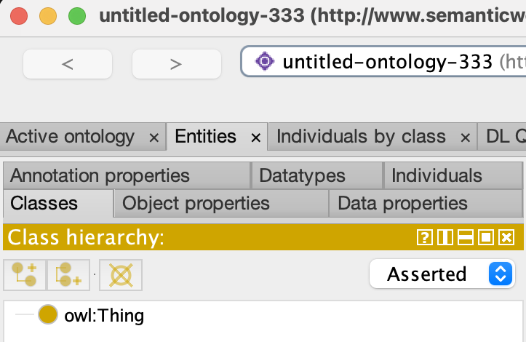
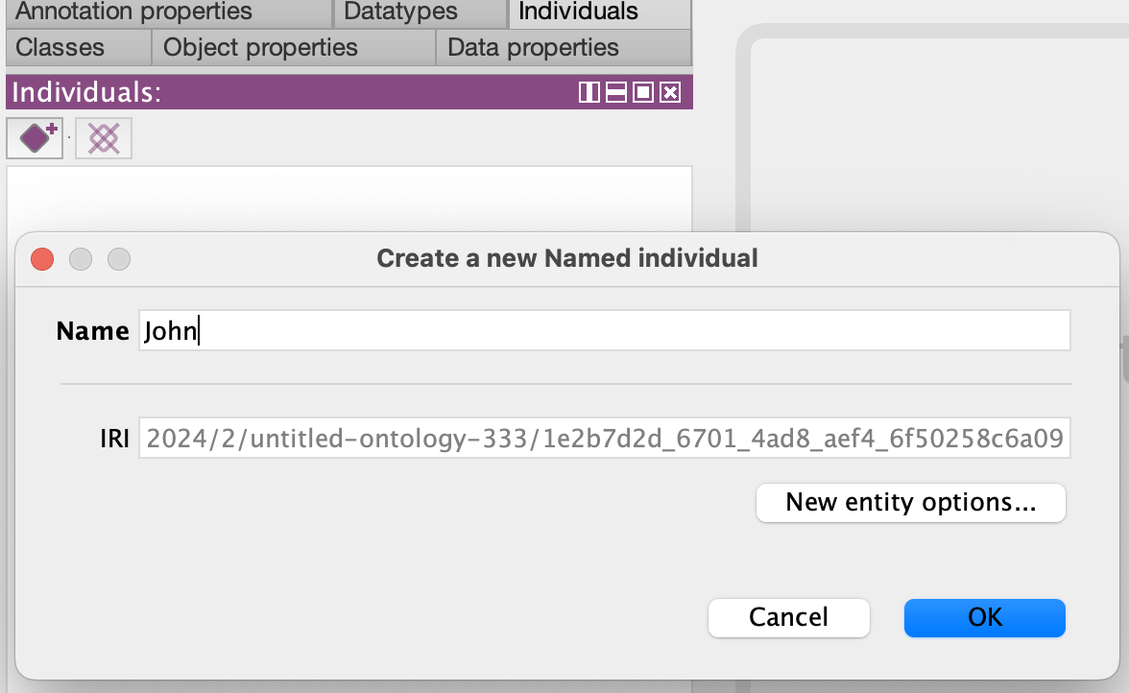
Protege
Open Protege, click on the “Individuals” tab, click on the purple diamond, then enter the name “John” in the pop-up screen

Slide 12
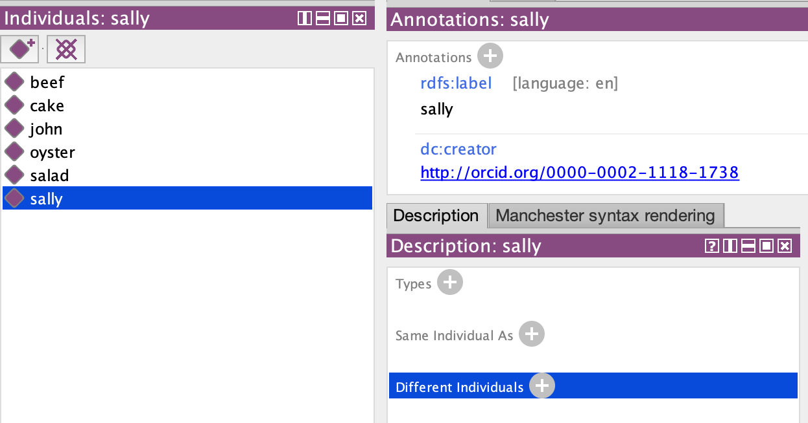
Protege
Add “Sally”, “Frank”, and “Otto”
Additionally, add oyster, beef, salad, and cake as individuals
Then assert they’re all distinct

Slide 13
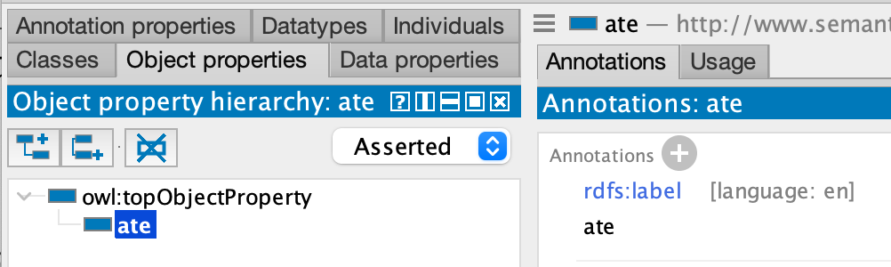
Protege
Navigate to the “object properties” tab
Then add the relation “ate” that intuitively holds between a person and the food they have eaten

Slide 14
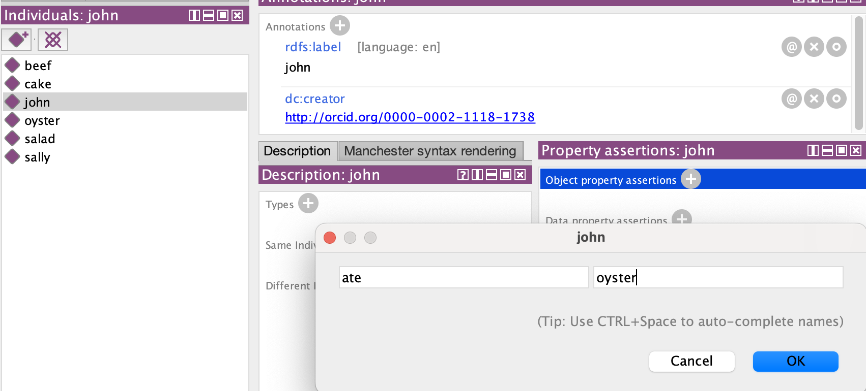
Protege
Now, back to the “Individuals” tab, select “John”, then and under the “Property assertions” section, click on the “+” next to “object property assertions”
Add that John ate oysters, beef, salad, and cake

Slide 15
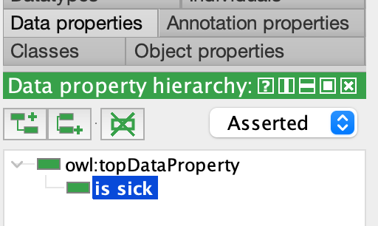
Protege
Navigate to the “data properties” tab
Then add the relation “is sick” that intuitively holds between a person and a string indicating that they are sick

Slide 16
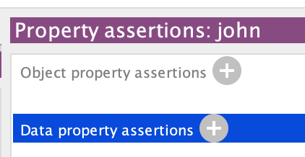
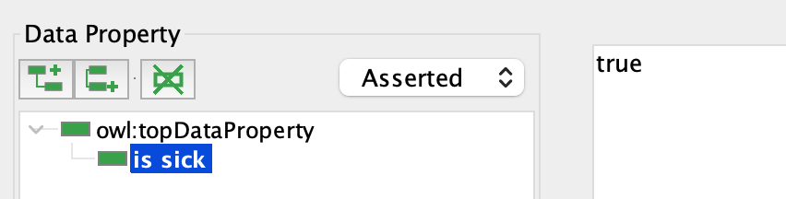
Protege
Now, back to the “Individuals” tab, select “John”, then and under the “Property assertions” section, click on the “+” next to “Data property assertions”
Select “is sick” from the hierarchy, then type “true” in the box

Slide 17
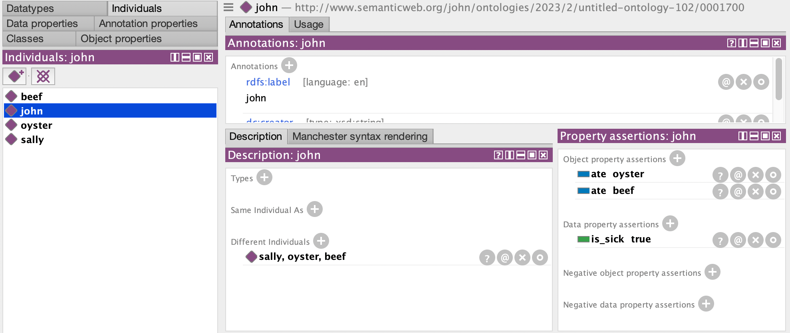

Slide 19
Protege Ontology Editor
Using Protege, we can represent that John ate beef, oysters, etc. and was consequently sick
Similarly, we can represent that Sally ate oysters and cake, but neither beef nor salad, and yet was also sick
https://protege.stanford.edu/

Slide 20
Illustrative Example
 | Oysters | Beef | Salad | Cake | Sick
John | Yes | Yes | Yes | Yes | Yes
Sally | Yes | No | No | Yes | Yes
Frank | Yes | Yes | No | No | Yes
Otto | Yes | No | Yes | No | Yes

Slide 21
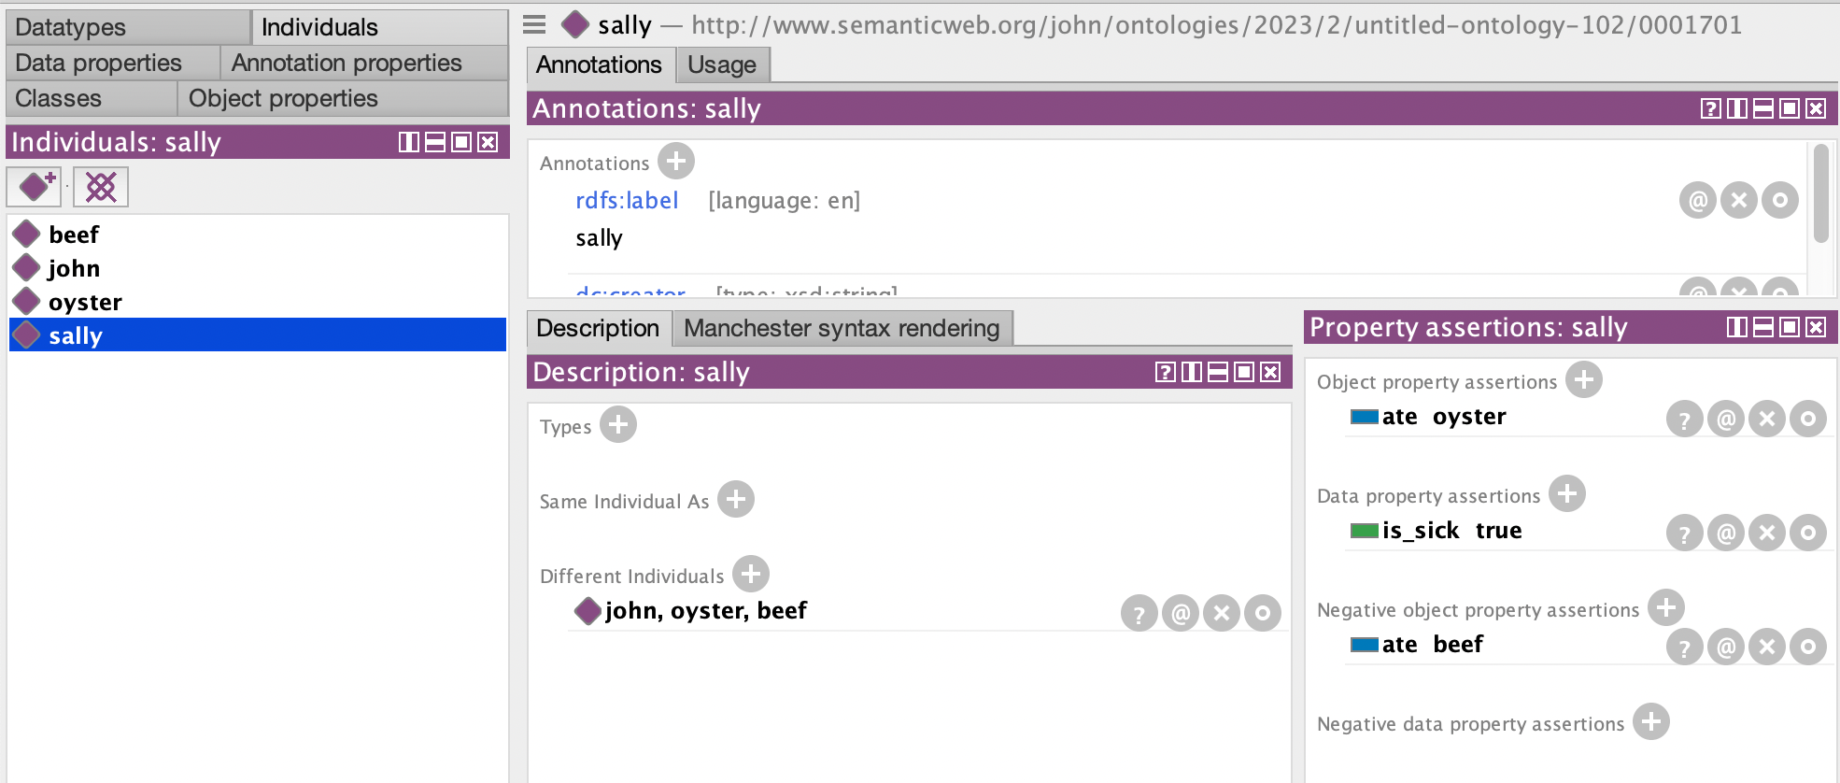

Slide 22
Protege Ontology Editor
To provide the full picture, we will also need to represent relatinships between persons and food, as well as the possible cause of illness
Additionally, we will need to include a way to assert that an individual is sick
https://protege.stanford.edu/

Slide 23
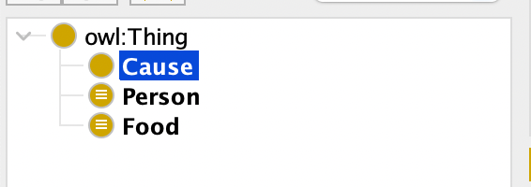
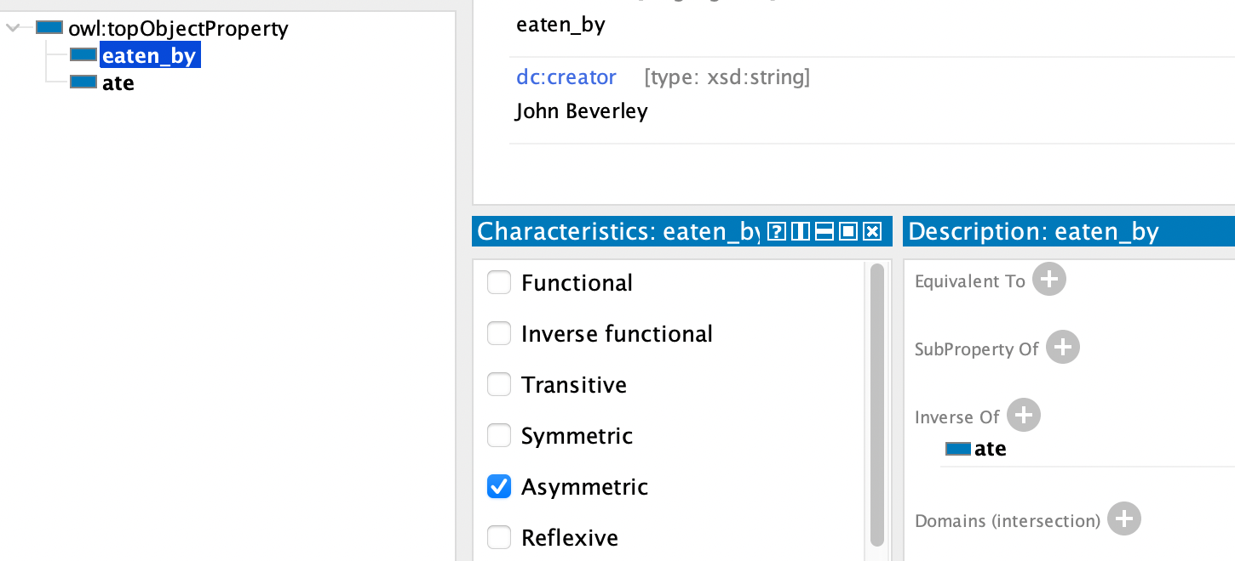
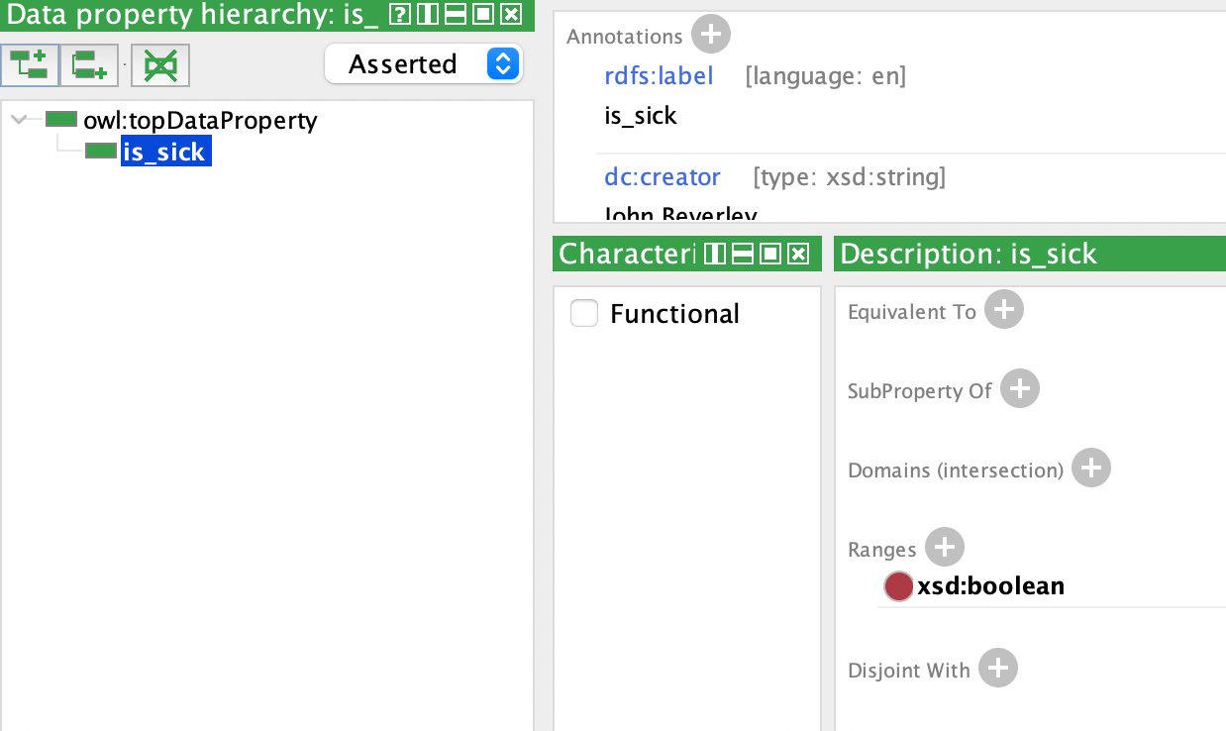

Slide 24
SWRL
The “Semantic Web Rule Language”, introduced to the semantic web community in 2004
SWRL allows you to represent conditional statements in ontologies that behave as rules with trigger conditions; for example:
ate(John, ?y) & is_sick(John, true) → cause(?y)
In words, if John ate something and is sick, what John ate caused his illness

Slide 25
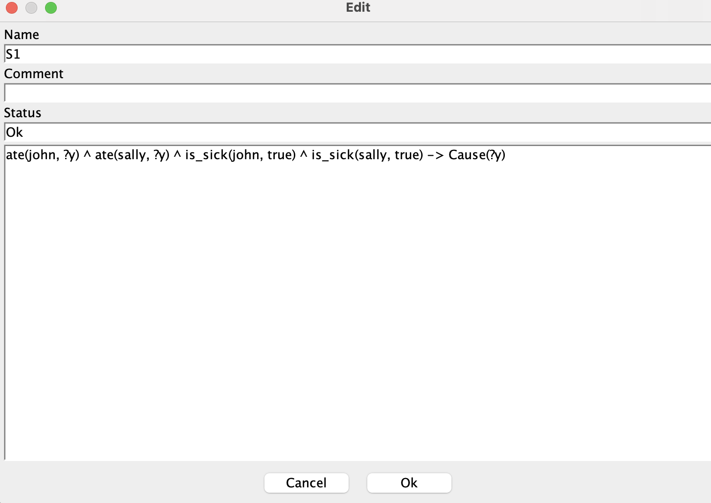
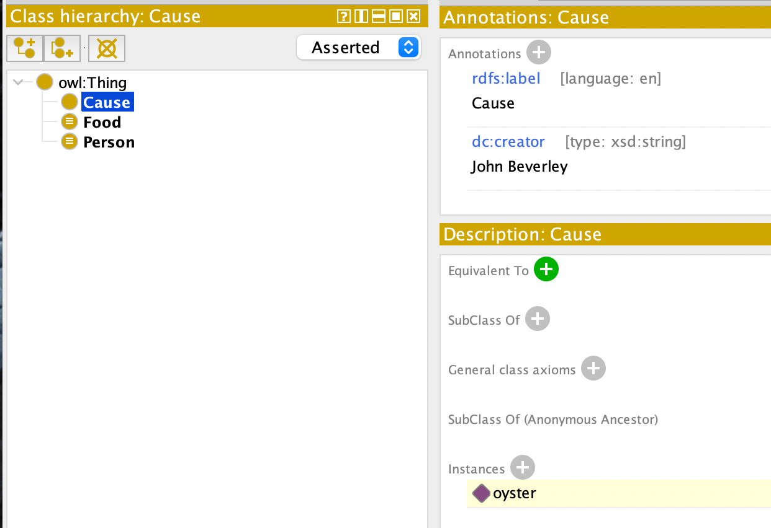

Slide 29
Illustrative Example
 | Oysters | Beef | Salad | Cake | Sick
John | Yes | Yes | Yes | Yes | Yes
Sally | Yes | No | No | Yes | Yes
Frank | Yes | Yes | No | No | Yes
Otto | Yes | No | Yes | No | Yes

Slide 30
Group Exercise
If all cases where an effect occurs have a single factor C in common, then C is the cause of the effect
MODEL THE ILLUSTRATIVE EXAMPLE USING PROTEGE AND SWRL RULES

Slide 31
Difference
If situation A leads to an effect and situation B does not, and the only difference between them is that A exhibits factor C, then C causes the effect

Slide 32
Difference
If situation A leads to an effect and situation B does not, and the only difference between them is that A exhibits factor C, then C causes the effect
If everyone became ill but the one person who didn’t eat a certain food, then that food is the cause of the illness

Slide 33
Illustrative Example
 | Oysters | Beef | Salad | Cake | Sick
John | Yes | Yes | Yes | Yes | Yes
Sally | Yes | Yes | Yes | Yes | Yes
Frank | Yes | Yes | Yes | Yes | Yes
Otto | Yes | Yes | No | Yes | No

Slide 34
Illustrative Example
 | Oysters | Beef | Salad | Cake | Sick
John | Yes | Yes | Yes | Yes | Yes
Sally | Yes | Yes | Yes | Yes | Yes
Frank | Yes | Yes | Yes | Yes | Yes
Otto | Yes | Yes | No | Yes | No

Slide 35
Group Exercise
If situation A leads to an effect and situation B does not, and the only difference between them is that A exhibits factor C, then C causes the effect
MODEL THE ILLUSTRATIVE EXAMPLE USING PROTEGE AND SWRL RULES

Slide 36
Agreement and Difference
If all cases where an effect occurs have a single factor C in common, then C is the cause of the effect

Slide 37
Agreement and Difference
If all cases where an effect occurs have a single factor C in common, then C is the cause of the effect
If situation A leads to an effect and situation B does not, and the only difference between them is that A exhibits factor C, then C causes the effect

Slide 38
Illustrative Example
 | Oysters | Beef | Salad | Cake | Sick
John | Yes | Yes | Yes | Yes | Yes
Sally | Yes | Yes | No | Yes | Yes
Frank | Yes | Yes | Yes | No | Yes
Otto | Yes | No | No | Yes | No

Slide 39
Illustrative Example
 | Oysters | Beef | Salad | Cake | Sick
John | Yes | Yes | Yes | Yes | Yes
Sally | Yes | Yes | No | Yes | Yes
Frank | Yes | Yes | Yes | No | Yes
Otto | Yes | No | No | Yes | No

Slide 40
Illustrative Example
 | Oysters | Beef | Salad | Cake | Sick
John | Yes | Yes | Yes | Yes | Yes
Sally | Yes | Yes | No | Yes | Yes
Frank | Yes | Yes | Yes | No | Yes
Otto | Yes | No | No | Yes | No

Slide 41
Illustrative Example
 | Oysters | Beef | Salad | Cake | Sick
John | Yes | Yes | Yes | Yes | Yes
Sally | Yes | Yes | No | Yes | Yes
Frank | Yes | Yes | Yes | No | Yes
Otto | Yes | No | No | Yes | No

Slide 42
Illustrative Example
 | Oysters | Beef | Salad | Cake | Sick
John | Yes | Yes | Yes | Yes | Yes
Sally | Yes | Yes | No | Yes | Yes
Frank | Yes | Yes | Yes | No | Yes
Otto | Yes | No | No | Yes | No

Slide 43
Illustrative Example
 | Oysters | Beef | Salad | Cake | Sick
John | Yes | Yes | Yes | Yes | Yes
Sally | Yes | Yes | No | Yes | Yes
Frank | Yes | Yes | Yes | No | Yes
Otto | Yes | No | No | Yes | No

Slide 44
Group Exercise
If all cases where an effect occurs have a single factor C in common, then C is the cause of the effect
MODEL THE ILLUSTRATIVE EXAMPLE USING PROTEGE AND SWRL RULES

Slide 45
Concomitant Variations
If several situations lead to an effect, and changes in the effect are correlated with changes in factor C common to those situations, then we can infer C is the cause

Slide 46
Concomitant Variations
If several situations lead to an effect, and changes in the effect are correlated with changes in factor C common to those situations, then we can infer C is the cause
If everyone gets sick, but how sick they are depends on how much of a certain food they ingested, then that food is the cause

Slide 47
Illustrative Example
 | Oysters | Beef | Salad | Cake | Sick
John | 1 | Same | Same | Same | Little
Sally | 1 | Same | Same | Same | Little
Frank | 4 | Same | Same | Same | Very
Otto | 12 | Same | Same | Same | Critical

Slide 48
Illustrative Example
 | Oysters | Beef | Salad | Cake | Sick
John | 1 | Same | Same | Same | Little
Sally | 1 | Same | Same | Same | Little
Frank | 4 | Same | Same | Same | Very
Otto | 12 | Same | Same | Same | Critical

Slide 49
Illustrative Example
 | Oysters | Beef | Salad | Cake | Sick
John | 1 | Same | Same | Same | Little
Sally | 1 | Same | Same | Same | Little
Frank | 4 | Same | Same | Same | Very
Otto | 12 | Same | Same | Same | Critical

Slide 50
Group Exercise
If several situations lead to an effect, and changes in the effect are correlated with changes in factor C common to those situations, then we can infer C is the cause
MODEL THE ILLUSTRATIVE EXAMPLE USING PROTEGE AND SWRL RULES

Slide 51
Outline
Mill’s Methods
Formal Properties of Relations

Slide 52
Descriptions
We refer to objects in the world directly and indirectly
If I point to Sam and say “There’s Sam!” I am referring to Sam directly
If I gesture in Sam’s direction and say “The person over there with a blue hat and red shoes” I am indirectly referring to Sam

Slide 53
Descriptions
When we refer to individuals and objects indirectly, we often describe properties they have
For example, by referring to Sam as wearing a hat, I am describing Sam as bearing the property wearing a hat
Properties are everywhere…

Slide 54
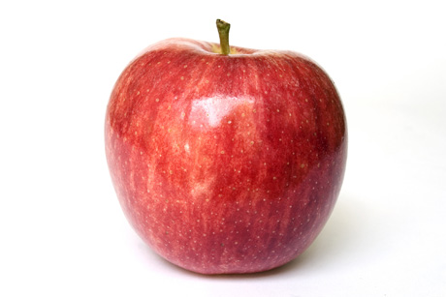
Descriptions

Slide 55
Descriptions
being red

Slide 56
Descriptions
being round

Slide 57
Descriptions
being an image

Slide 58

Descriptions
being an image

Slide 59
Entailments
Some natural language properties link to other properties
For example: If an apple is red then the apple has a color
As another: If an apple is round then it has a shape
And of course: If an object is an image then represents something

Slide 60
Entailments
Identifying these relationships may help you learn a lot of information based on just a bit
Suppose you’re playing the game Clue
You know at least one person has committed a murder, but not which; you uncover properties which, when combined, narrow the culprit

Slide 61

Relations
Perhaps more interesting, are two-placed properties, or what are known as relations
For example:
John is taller than Sam

Slide 62
Relations
Perhaps more interesting, are two-placed properties, or what are known as relations
For example:
John is taller than Sam
taller than
Sam
John

Slide 63
Relations
Perhaps more interesting, are two-placed properties, or what are known as relations
For example:
John is taller than Sam
Sam is next to John
next to
Sam
John

Slide 64
Relations
Perhaps more interesting, are two-placed properties, or what are known as relations
For example:
John is taller than Sam
Sam is next to John
Sam is smarter than John
smarter than
Sam
John

Slide 65
Relations
Perhaps more interesting, are two-placed properties, or what are known as relations
For example:
John is taller than Sam
Sam is next to John
Sam is smarter than John
John is heavier than Sam
heavier than
Sam
John

Slide 66
Relations
Perhaps more interesting, are two-placed properties, or what are known as relations
For example:
John is taller than Sam
Sam is next to John
Sam is smarter than John
John is heavier than Sam
Sam is the smartest person in the room
smarter than
Sam
John

Slide 67
Relations
Relations themselves have properties in natural language, which can reveal lots of information
For example:
John next to Sam, means Sam is next to John
Sam
John

Slide 68
Relations
Relations themselves have properties in natural language, which can reveal lots of information
For example:
John next to Sam, means Sam is next to John
next to
Sam
John
next to

Slide 69
Relations
Relations themselves have properties in natural language, which can reveal lots of information
For example:
John next to Sam, means Sam is next to John
John taller than Sam and Sam taller than Sally, means John is taller than Sally
taller than
Sally
Sam
John
taller than

Slide 70
Relations
Relations themselves have properties in natural language, which can reveal lots of information
For example:
John next to Sam, means Sam is next to John
John taller than Sam and Sam taller than Sally, means John is taller than Sally
Sally
Sam
John
taller than

Slide 71
Relations
Relations themselves have properties in natural language, which can reveal lots of information
For example:
John next to Sam, means Sam is next to John
John taller than Sam and Sam taller than Sally, means John is taller than Sally
Sam as the smartest person in the room, means Sam is smarter than anyone in the room
smarter than
Sally
Sam
John
smarter than

Slide 72
Reflexivity
A relation is reflexive just in case for anything it might apply to, that thing is related to itself
For example, the relation identical to is reflexive
This is because any x is always identical to itself

Slide 73
Symmetry
A relation is symmetric just in case if one thing is related to another, the reverse relation holds as well
For example, the relation next to is symmetric
If x is next to y then y is next to x

Slide 74
Symmetry
Some natural language relations have more than one property
For example, the relation is identical to is both symmetric and reflexive
That is, if x is identical to y, then y is identical to x, and x is identical to x and y is identical to y

Slide 75
Transitive
A relation is transitive just in case if an object is related to another, which itself is related to a third, then the first is also related to the third
For example, the relation is taller than is transitive
If x is taller than y and y is taller than z, then x is taller than z

Slide 76
Transitive
The relation is identical to is also transitive
Any relation that has all three of these properties, reflexive, symmetric, and transitive, is called an equivalence relation
Spotting equivalence relations allows you to group things in a coarse-grained manner

Slide 77
Equivalence Relation
For example, consider the relation has the same father as
Now suppose there are several people who bear this relation to each other
If x has the same father as y, then y has the same father as x
Anyone in this group has the same father as themselves, etc.

Slide 78
Parthood
Let’s examine a rather well-studied natural language relation is part of
Denote this relation with “P”
For example, to say John’s elbow is part of John, we’re write “Pej”

Slide 79
Parthood
Which of the following seem true:
Pxx
If Pxy then Pyx
If Pxy and Pyz then Pxz

Slide 80
Parthood
Which of the following seem true:
Pxx
If Pxy then Pyx
If Pxy and Pyz then Pxz

Slide 81
Parthood
Which of the following seem true:
Pxx
If Pxy then Pyx
If Pxy and Pyz then Pxz

Slide 82
Parthood
Which of the following seem true:
Pxx
Everything is part of itself…the maximal part!
Consider just John’s leg…now combine this with John’s torso, elbows, etc., until you have all John’s (proper) parts…what’s the result?

Slide 83
Parthood
Now, is part of does not seem symmetric
In fact, it seems intuitive to say that is part of is not symmetric
We might capture this as: If Pxy then it is not the case that Pyx
But this cannot work…

Slide 84
Parthood
SUPPOSE: If Pxy then it is not the case that Pyx
The ‘x’ and ‘y’ can be anything in our domain; they’re unrestricted
But that means whatever is being picked out by ‘x’ might be the same thing as whatever is being picked out by ‘y’
So we can replace “Pxy” with “Pxx”

Slide 85
Parthood
SUPPOSE: If Pxy then it is not the case that Pyx
Which means with our supposition we have: If Pxx then it is not the case that Pxx
But that’s a contradiction!
So we have to take back our supposition

Slide 86
Parthood
Still, we don’t want to say that is part of is symmetric; that’s crazy
We get around this by introducing another property:
Anti-symmetric: If Pxy and Pyx then x=y
This is consistent with reflexivity

Slide 87
Contained In
Leibniz’s Law: If x=y then any property x has, y has
This applies to properties of relations…
We’ve said is part of is reflexive, antisymmetric, and transitive
Is the relation is contained in the same relation as is part of?

Slide 88
Contained In
Leibniz’s Law: If x=y then any property x has, y has
Consider whether is contained in is transitive…antisymmetric…reflexive…

Slide 89
Contained In
Leibniz’s Law: If x=y then any property x has, y has
Consider whether is contained in is transitive…antisymmetric…reflexive…

Slide 90
Contained In
Leibniz’s Law: If x=y then any property x has, y has
Consider whether is contained in is transitive…antisymmetric…reflexive…
It is not reflexive…and that’s enough to show is contained in is not the same relation as is part of

Slide 91
Properties of Attitudes
What goes for relations goes for attitudes
By “attitude” I mean something like belief, knows, wishes, desires
In other words, cognitive attitudes between an individual and some content, e.g. “A cheesecake”, “The Torah by heart”, “To be a millionaire”, “To get a job”

Slide 92
Properties of Attitudes
Attitudes bear properties too…
If John knows viruses are obligate parasites
Then John believes viruses are obligate parasites
RATIONAL: If S knows P then S believes P

Slide 93
Properties of Attitudes
If John wishes viruses to be obligate parasites
Then John desires viruses to be obligate parasites
CONATIVE: If S wishes P then S desires P

Slide 94
Properties of Attitudes
Can John imagine a round square?
No.
CONTRADICTION: If “P” is a contradiction, then it is not the case that S can imagine P

Slide 95
Properties of Attitudes
Can John know there is a round square?
No.
CONTRADICTION: If “P” is a contradiction, then it is not the case that S can know P

Slide 96
Properties of Attitudes
But John could suppose there is a round square
And John could wish there is a round square
Neither of these attitudes satisfy CONTRADICTION

Slide 97
Properties of Attitudes
If John imagines that John imagines the sky is green, then John imagines the sky is green
If John wants to want to obey the law, it doesn’t follow that John wants to obey the law
COLLAPSE: If S imagines that S imagines P, then S imagines P

Slide 98
Properties of Attitudes
If John imagines that John imagines the sky is green, then John imagines the sky is green
If John wants to want to obey the law, it doesn’t follow that John wants to obey the law
COLLAPSE: If S wants that S wants P, then S wants P

Slide 99
Properties of Attitudes
It doesn’t make sense to say:
“I know it’s raining and I don’t believe it”
This is just belief and knowledge being logically connected

Slide 100
Properties of Attitudes
And it’s okay to say:
“I believe it’s raining but I don’t know it”
“I believe raining outside but I suppose it isn’t”
“I know raining outside but I imagine it isn’t”
“I know raining outside but I wish it wasn’t”

Slide 101
Properties of Attitudes
It doesn’t sound right to say:
“I have the coffee and I want the coffee”
S can continue to want to keep P, but that’s different…
OWNERSHIP: If S has P, then S cannot desire P

Slide 102
Group Exercise
Identify properties of the following relations:
x is happier than y
x is contained in y
Identify properties of the following attitudes:
S fears P
S loves P

